Slide 1
FARMER ENHANCER
Group Members – Shubham Sirsat (220343120103)
Bhushan Badgujar (220343120021)
Yogesh Patil (220343120077)
Sandeep Pawar (220343120094)
Project Guide – Mrs. Harshita Maheshwari

Slide 2
Contents
Introduction
Choice of topic
Proposed System
Methodology
Proposed System Model
Proposed Approach
Screenshot
System Requirements
Applications
Advantages & Limitations
Conclusion
Future Scopes
References

Slide 3
Introduction
Farmer Enhancer Project is a web application to help farmers, exporters as well as seed suppliers.
This will help to trade vegetables and fruits and also provides provision for seeds.
It provides admin, farmer, exporter and seed supplier login.
Farmers & seed suppliers can add different crops and seeds..
This application provides feedback system for better performance.
This application allows a good communication.

Slide 4
Choice of topic
Through this project farmers ensure great profitability.
Availability of seeds to the farmer in efficient way.
Easy , Fast and new online platform
Directly helps for growth of seed suppliers.
Products and transportation charges facility.

Slide 5
Proposed System
AIM:
1. It will help local farmers financially.
Proposed System:
1. Digitalize Exporting and Farming
2. Communication can take place through mobile and computer.
3. Eliminate Intermediates so its positive sign for both buyer and seller.

Slide 6
Methodology
The objective is to create a web site that can perform the following:-
Creating a Single Page Application by using React JS to achieve faster and smoother performance.
Read the product data logically added by farmer, seed supplier and admin.
Creating a local database.

Slide 7
Proposed System Model
There are four main modules:
Admin
Order List
Customer List
Product List
Feedback
Logout
Farmer
Product Details
Seed Details
Requested Goods
My Orders
Feedback
Logout

Slide 8
Exporter
Product Details
Requested Goods
My Orders
Order
Logout
Seed Supplier
Seed Details
Requested Goods
My Orders
Feedback
Logout

Slide 9
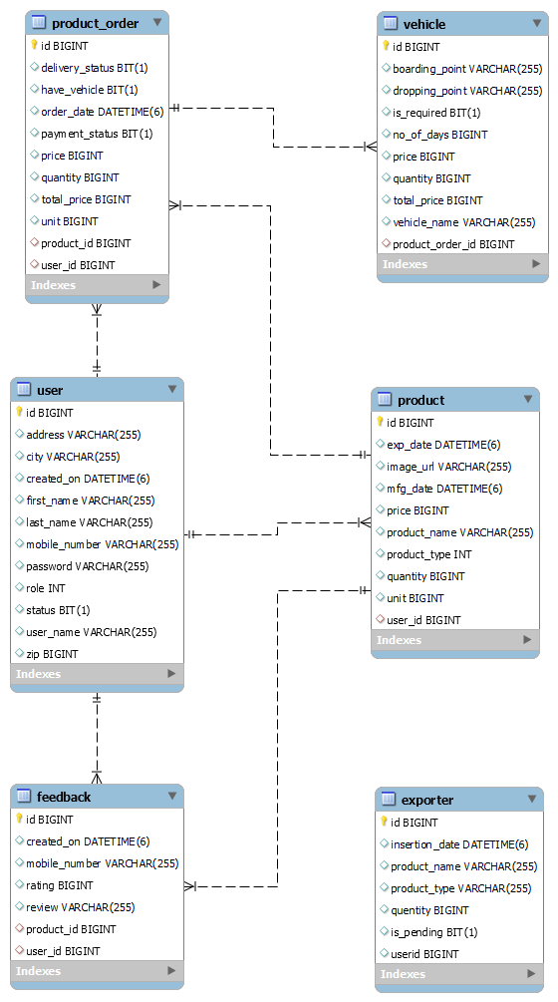
Proposed Approach

Slide 10
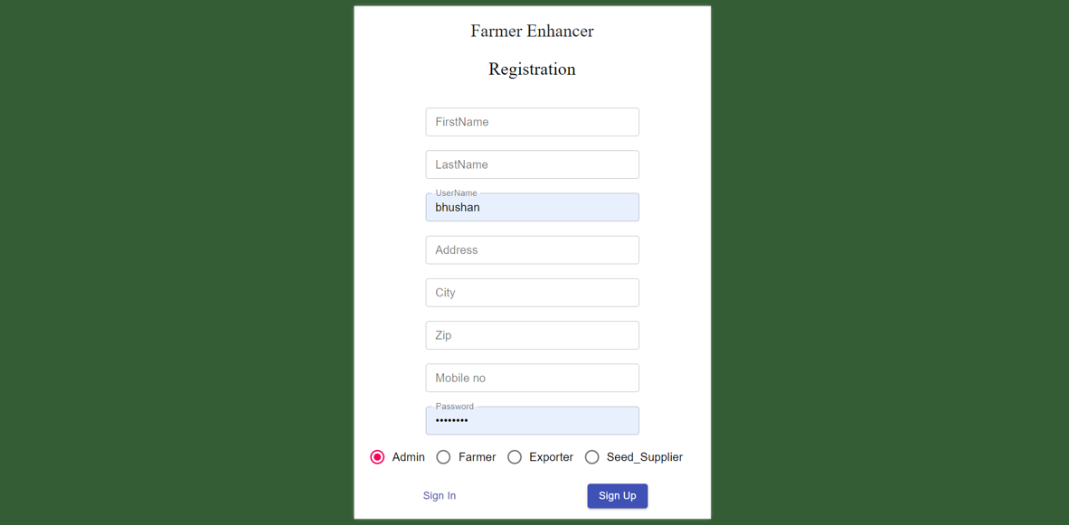
Screenshots

Slide 11
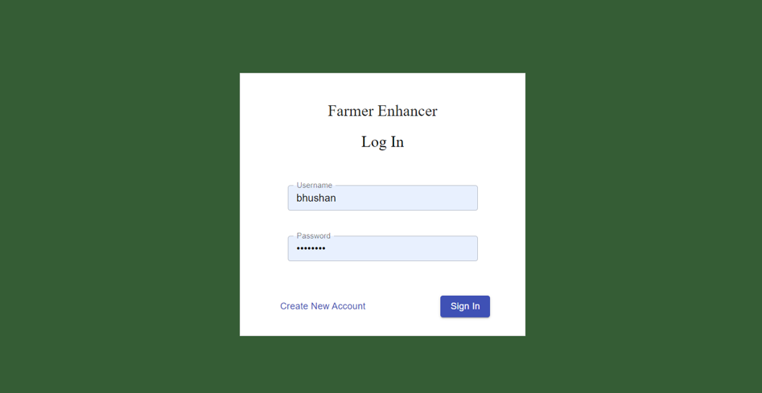

Slide 12
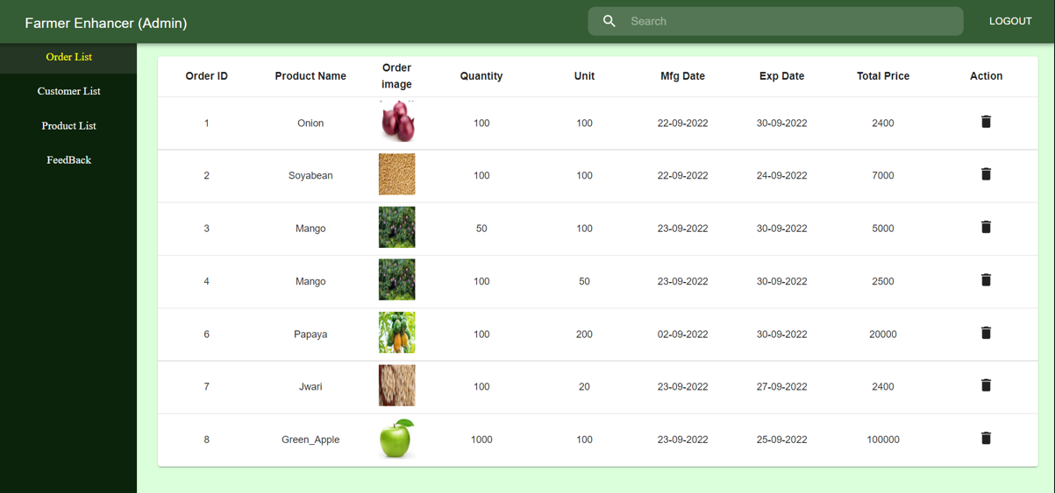

Slide 13
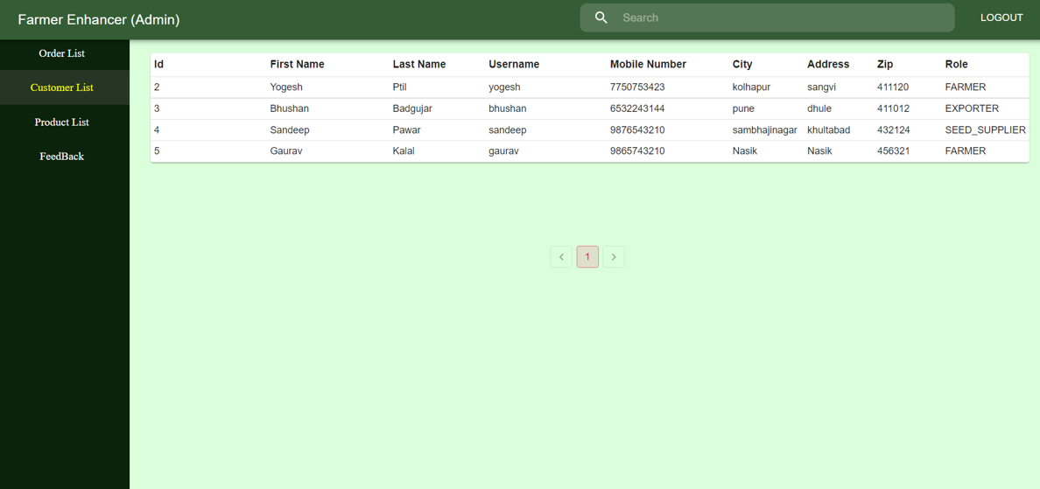

Slide 14
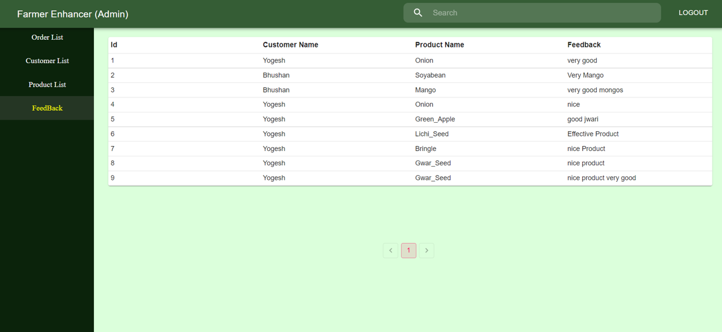

Slide 15
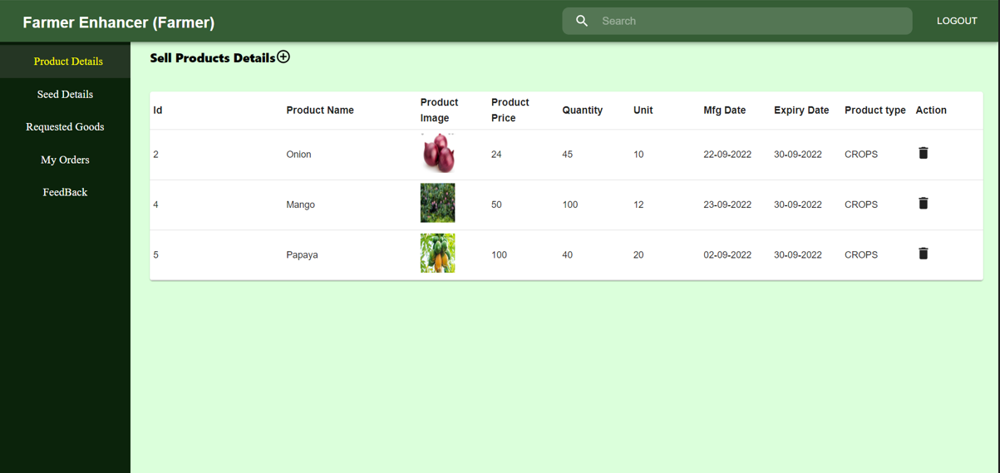

Slide 16
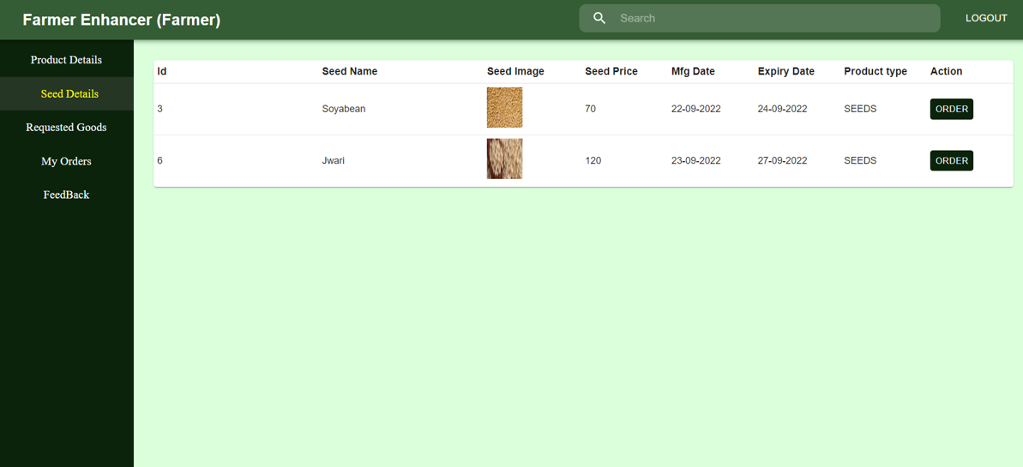

Slide 17
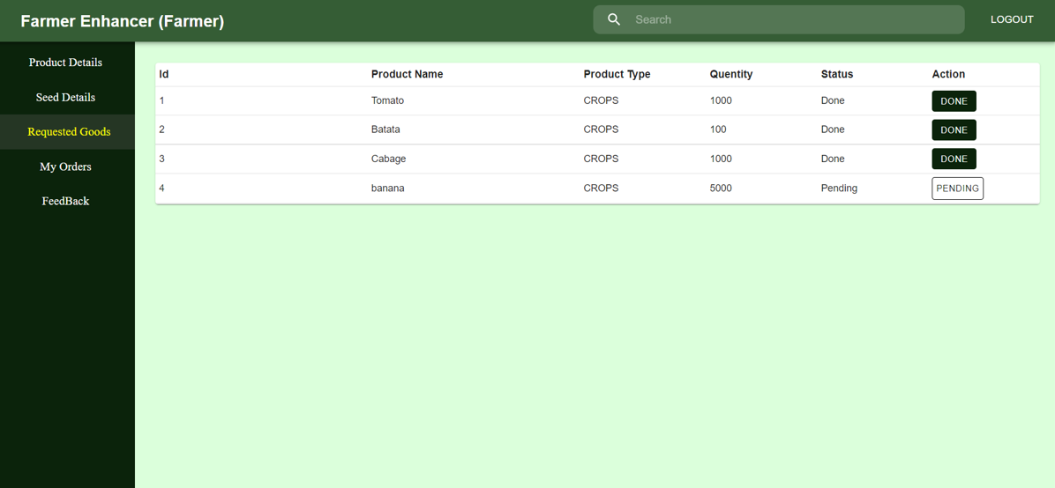

Slide 18
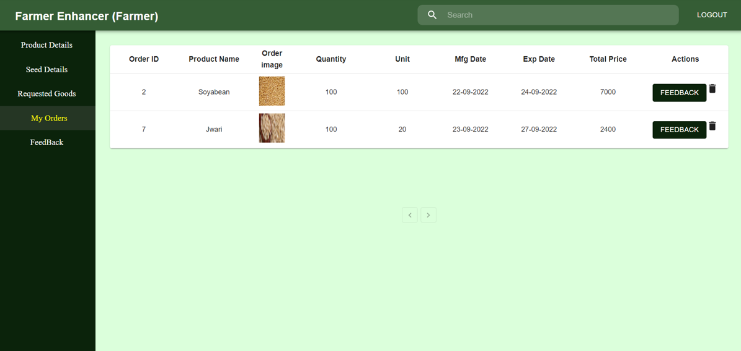

Slide 19
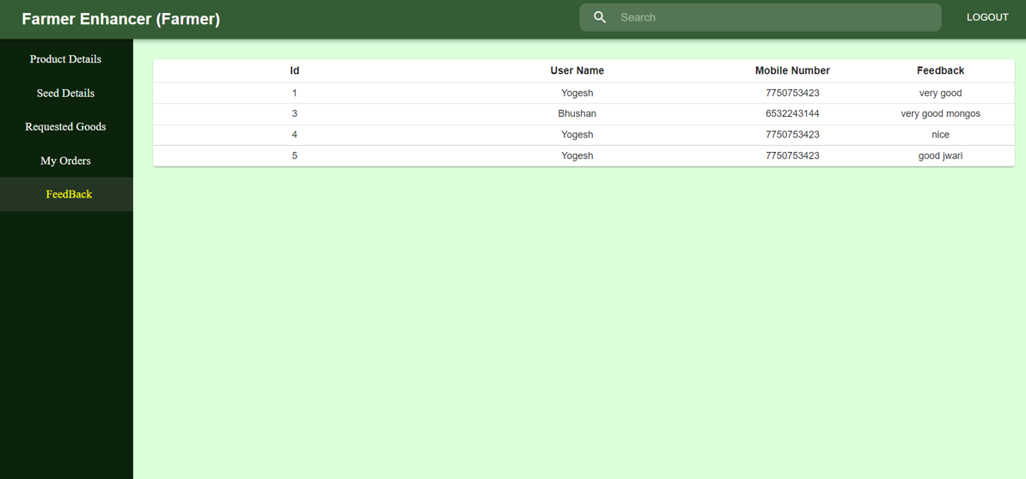

Slide 20
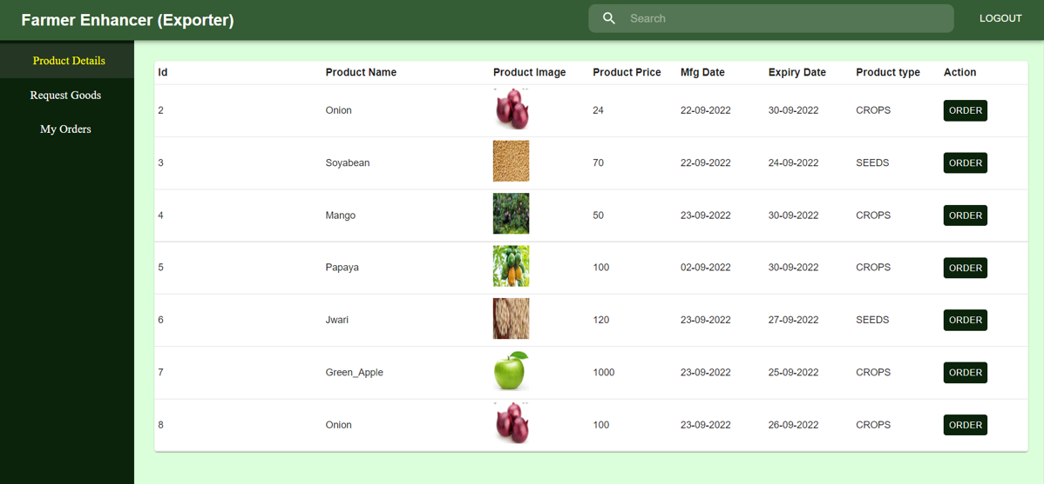

Slide 21
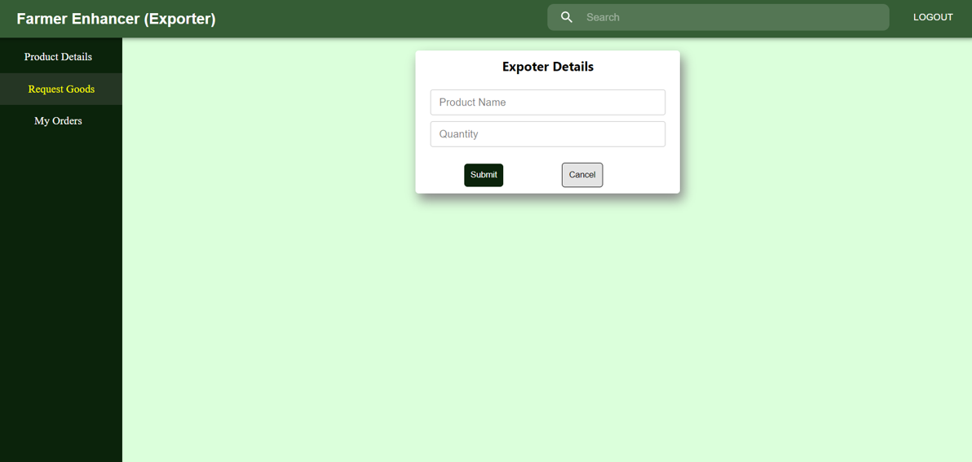

Slide 22
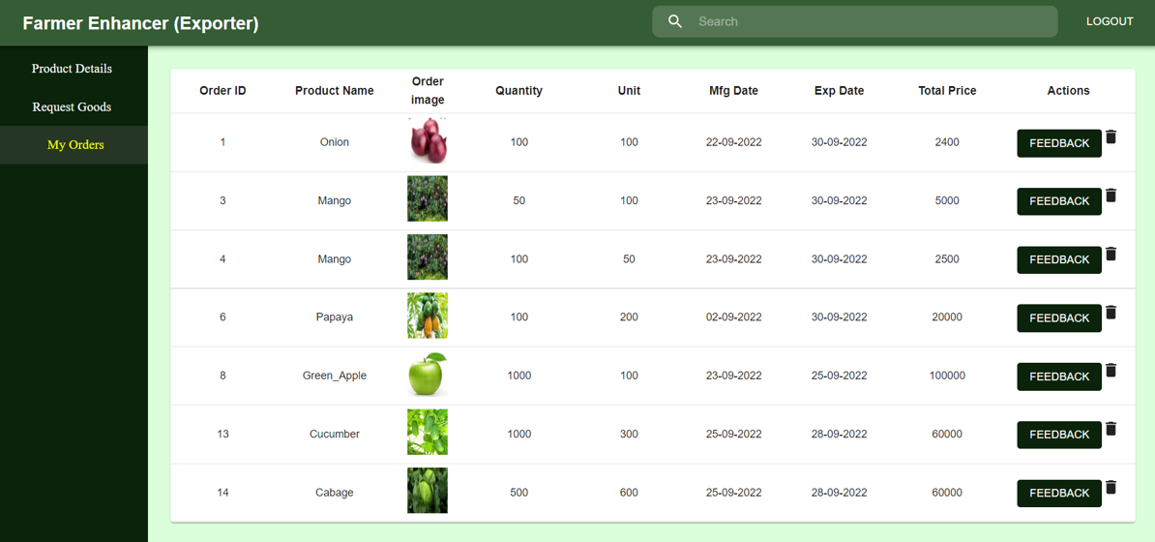

Slide 23
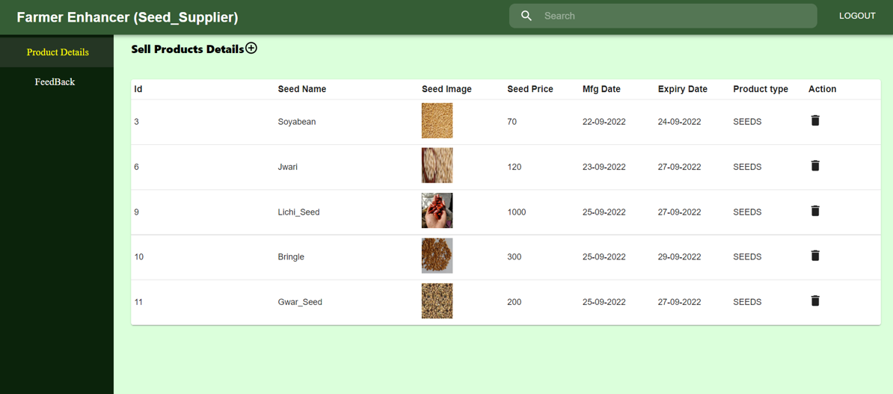

Slide 24
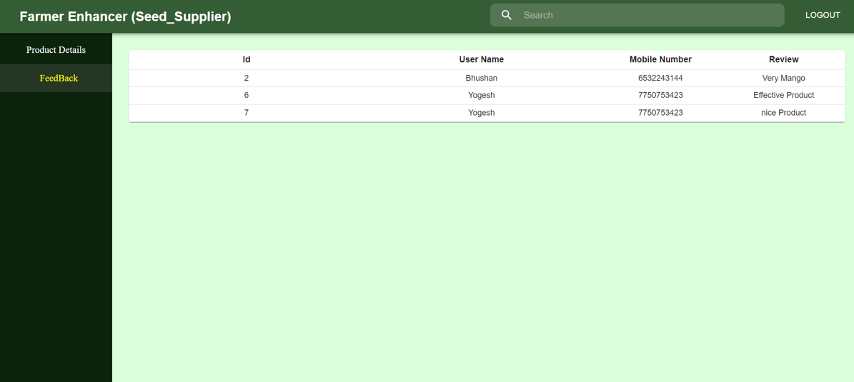

Slide 25
System Requirements
Software Requirements:
• Windows (All Versions)
• Apache Tomcat 8.5
• Eclipse, MySQL, VS Code
Hardware Components:
• Processor – i3
• Hard Disk – 5 GB
• Memory – 2GB RAM

Slide 26
Technologies Used
React JS: Single page application has been created by using React JS.
CSS : Used to style and layout web pages.
JavaScript : All Validation task and interactive ness has been developed by JS.
Spring boot : All back end web application built by using spring boot.
Spring JPA : All relational data management acquired by spring JPA.
JWT: All authentication has been done by using JWT.
MySQL : MySQL database has been used as database.
Apache Tomcat : Web Application will run using Tomcat server.

Slide 27
Applications
Digital Exporting and Farming.
Multi user application so can be used by buyers, sellers and material providers.
Provide efficient growth for every user.
It provides contribution in improvisation of India’s farming sector.

Slide 28
Advantages
Transparency in the system.
Saves Time, cost and energy.
Increase profitability of all users.
Farmers and seed suppliers can submit their products online.
All exporters and farmers can buy products from product list.

Slide 29
Limitations
Accurate verification of the users cannot be done online.
It requires an extensive database and memory.

Slide 30
Conclusion
The Farmer Enhancer web service was created to address the needs of the modern era while overcoming the limitations of the previous manual system. This system will digitalize the agricultural sector and increase farmers' profits. By eliminating intermediaries, it will increase transparency between farmers, suppliers, and exporters. Using this portal will help everyone save time and energy. Finally, it can be improved in the future in response to growing user demand.

Slide 31
Future Scope
Verification of users.
Improvement in design.
Increase more transparency.
Mobile Application
Integration of new function like farmers can rent equipment according to their need
Chat BOT

Slide 32
References
Mr. Saleel Bagde for MySQL Database.
Mrs. Harshita Maheshwari for React JS & CSS also she was our project guide.
Mrs. Mayuri Fakirpure for Spring Boot, Spring JPA in JAVA.
https://www.slideshare.net
https://www.projectideas.co.in
https://www.enam.gov.in/web/
The Farmers Produce Trade and Commerce(Promotion and Facilitation) Ordinance, 2020.

Slide 33
THANK YOU

